Slide 1
Database-Connection Libraries
Call-Level Interface Java Database Connectivity
PHP

Slide 2
An Aside: SQL Injection
SQL queries are often constructed by programs.
These queries may take constants from user input.
Careless code can allow rather unexpected queries to be constructed and executed.

Slide 3
Example: SQL Injection
Relation Accounts(name, passwd, acct).
Web interface: get name and password from user, store in strings n and p, issue query, display account number.
SELECT acct FROM Accounts
WHERE name = :n AND passwd = :p

Slide 4
User (Who Is Not Bill Gates) Types
Comment
in Oracle
Name:
gates’
--
Password:
who cares?
Your account number is 1234-567

Slide 5
The Query Executed
SELECT acct FROM Accounts WHERE name = ’gates’ --
’ AND
passwd = ’who cares?’
All treated as a comment

Slide 6
Host/SQL Interfaces Via Libraries
The third approach to connecting databases to conventional languages is to use library calls.
C + CLI
Java + JDBC
PHP + PEAR/DB

Slide 7
Three-Tier Architecture
A common environment for using a database has three tiers of processors:
Webservers-- talk to the user.
Applicationservers-- execute the business logic.
Databaseservers-- get what the app servers need from the database.

Slide 8
Example: Amazon
Database holds the information about products, customers, etc.
Business logic includes things like “what do I do after someone clicks ‘checkout’?”
Answer: Show the “how will you pay for this?” screen.

Slide 9
Environments, Connections, Queries
The database is, in many DB-access languages, an environment.
Database servers maintain some number of connections, so app servers can ask queries or perform modifications.
The app server issues发布语句 statements:
queries and modifications, usually.

Slide 10
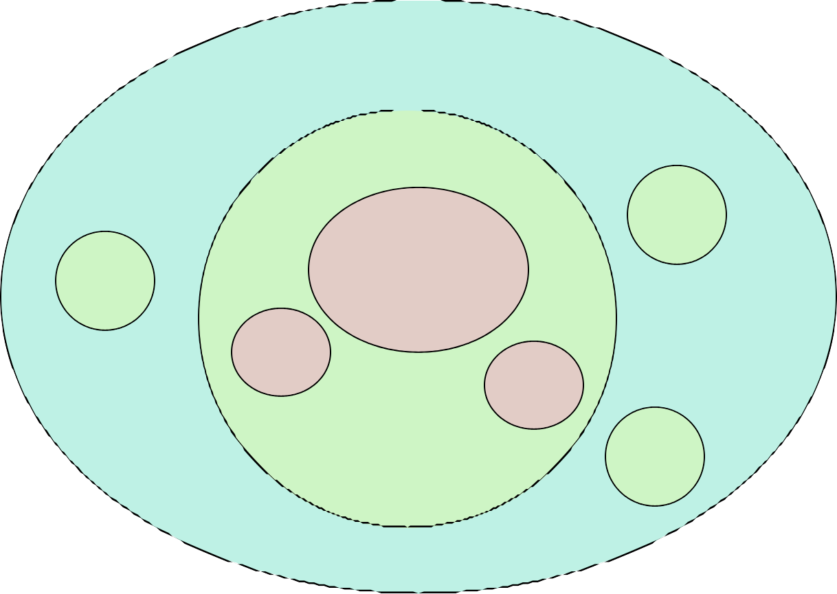
Diagram to Remember
Environment
Connection Statement

Slide 11
SQL/CLI
Instead of using a preprocessor (as in embedded 嵌入式SQL), we can use a library of functions.
The library for C is called SQL/CLI = “Call-Level Interface调用级 接口.”
Embedded SQL’s preprocessor will translate the EXEC SQL … statements into CLI or similar calls, anyway.

Slide 12
Data Structures
C connects to the database by structs of the following types:
Environments: represent the DBMS installation.
Connections: logins to the database.
Statements: SQL statements to be passed to a connection.
Descriptions:records about tuples from a query, or parameters of a statement.

Slide 13
Handles
Function SQLAllocHandle(T,I,O) is used to create these structs, which are called environment, connection, and statement handles.
T= type, e.g., SQL_HANDLE_STMT.
I= input handle = struct at next higher level (statement < connection < environment).
O= (address of) output handle.

Slide 14
Example: SQLAllocHandle
SQLAllocHandle(SQL_HANDLE_STMT, myCon, &myStat);
myCon is a previously created connection handle.
myStat is the name of the statement handle that will be created.

Slide 15
Preparing and Executing
SQLPrepare(H, S, L) causes the string S, of length L, to be interpreted as a SQL statement and optimized; the executable statement is placed in statement handle H.
SQLExecute(H) causes the SQL statement represented by statement handle H to be executed.

Slide 16
Example: Prepare and Execute
SQLPrepare(myStat, ”SELECT beer, price FROM Sells
WHERE bar = ’Joe’’s Bar’”,
);
SQLExecute(myStat);
SQL_NTS
This constant says the second argument
is a “null-terminated string”; i.e., figure out the length by counting characters.

Slide 17
Direct Execution
If we shall execute a statement S only once, we can combine PREPARE and EXECUTE with:
SQLExecuteDirect(H,S,L);
As before, H is a statement handle and L
is the length of string S.

Slide 18
Fetching Tuples
When the SQL statement executed is a query, we need to fetch the tuples of the result.
A cursor is implied by the fact we executed a query; the cursor need not be declared.
SQLFetch(H) gets the next tuple from the result of the statement with handle H.

Slide 19
Accessing Query Results
When we fetch a tuple, we need to put the components somewhere.
Each component is bound to a variable by the function SQLBindCol.
This function has 6 arguments, of which we shall show only 1, 2, and 4:
1 = handle of the query statement. 2 = column number.
4 = address of the variable.

Slide 20
Example: Binding
Suppose we have just done SQLExecute(myStat), where myStat is the handle for query
SELECT beer, price FROM Sells
WHERE bar = ’Joe’’s Bar’
Bind the result to theBeer and thePrice: SQLBindCol(myStat, 1, , &theBeer, , ); SQLBindCol(myStat, 2, , &thePrice, , );

Slide 21
Example: Fetching
Now, we can fetch all the tuples of the answer by:
while ( SQLFetch(myStat) !=
{
SQL_NO_DATA
)
/* do something with theBeer and thePrice */
CLI macro representing
SQLSTATE = 02000 = “failed
to find a tuple.”
}

Slide 22
JDBC
JavaDatabaseConnectivity（JBDC）is a library similar to SQL/CLI, but with Java as the host language.
Like CLI, but with a few differences for us to cover.

Slide 23
Making a Connection
The JDBC classes
import ;
java.sql.*
Class.forName(
com.mysql.jdbc.Driver
);
Connection myCon =
.getConnection );
DriverManager
(…
The driver for mySql; others exist
Loaded by forName
URL of the database
your name, and password go here.

Slide 24
Statements
JDBC provides two classes:
Statement = an object that can accept a string that is a SQL statement and can execute such a string.
PreparedStatement = an object that has an associated SQL statement ready to execute.

Slide 25
Creating Statements
The Connection class has methods to create Statements and PreparedStatements.
Statement stat1 = myCon.c (); PreparedStatement stat2 =
myCon. t(
reateStatement
createStatemen
”SELECT beer, price FROM Sells ” + ”WHERE bar = ’Joe’ ’s Bar’ ”
createStatement with no argument returns a Statement; with one argument it returns
);
a PreparedStatement.
25

Slide 26
Executing SQL Statements
JDBC distinguishes queries from modifications, which it calls “updates.”
Statement and PreparedStatement each have methods executeQuery and executeUpdate.
For Statements: one argument: the query or modification to be executed.
For PreparedStatements: no argument.

Slide 27
Example: Update
stat1 is a Statement.
We can use it to insert a tuple as:
stat1.executeUpdate(
”INSERT INTO Sells ” + ”VALUES(’Brass Rail’,’Bud’,3.00)”
);

Slide 28
Example: Query
stat2 is a PreparedStatement holding the query ”SELECT beer, price FROM Sells WHERE bar = ’Joe’’s Bar’ ”.
executeQuery returns an object of class ResultSet – we’ll examine it later.
The query:
ResultSet menu = stat2.executeQuery();

Slide 29
Accessing the ResultSet
An object of type ResultSet is something like a cursor.
Method next() advances the “cursor” to the next tuple.
The first time next() is applied, it gets the first tuple.
If there are no more tuples, next() returns the value false.

Slide 30
Accessing Components of Tuples
When a ResultSet is referring to a tuple, we can get the components of that tuple by applying certain methods to the ResultSet.
Method getX(i), where X is some type, and i is the component number, returns the value of that component.
The value must have type X.

Slide 31
Example: Accessing Components
Menu = ResultSet for query “SELECT beer, price FROM Sells WHERE bar = ’Joe’ ’s Bar’ ”.
Access beer and price from each tuple by:
while ( menu.next() ) {
theBeer = Menu.getString(1); thePrice = Menu.getFloat(2);
/*something with theBeer and thePrice*/
}
31

Slide 32
PHP
A language to be used for actions within HTML text.
Indicated by <? PHP code ?>.
DB library exists within PEAR (PHP Extension and Application Repository).
Include with include(DB.php).

Slide 33
Variables in PHP
Must begin with $.
OK not to declare a type for a variable.
But you give a variable a value that belongs to a “class,” in which case, methods of that class are available to it.

Slide 34
String Values
PHP solves a very important problem for languages that commonly construct strings as values:
How do I tell whether a substring needs to be interpreted as a variable and replaced by its value?
PHP solution: Double quotes means replace; single quotes means don’t.

Slide 35
Example: Replace or Not?
$100 | = | ”one | hundred | dollars”;
$sue | = | ’You | owe me | $100.’;
$joe | = | ”You | owe me | $100.”;
Value of $sue is ’You owe me $100’, while the value of $joe is ’You owe me one hundred dollars’.

Slide 36
PHP Arrays
Two kinds: numeric and associative.
Numeric arrays are ordinary, indexed 0,1,…
Example: $a = array(”Paul”, ”George”, ”John”, ”Ringo”);
Then $a[0] is ”Paul”, $a[1] is ”George”, and so on.

Slide 37
Associative Arrays
Elements of an associative array $a are pairs x => y, where x is a key string and y is any value.
If x => y is an element of $a, then
$a[x] is y.

Slide 38
Example: Associative Arrays
An environment can be expressed as an associative array, e.g.:
$myEnv = array(
”phptype” => ”oracle”,
”hostspec” => ”www.stanford.edu”, ”database” => ”cs145db”, ”username” => ”ullman”, ”password” => ”notMyPW”);

Slide 39
Making a Connection
With the DB library imported and the array $myEnv available:
$myCon = ($myEnv);
Function connect in the DB library
DB::connect
Class is Connection because it is returned by DB::connect().
39

Slide 40
Executing SQL Statements
Method query applies to a Connection object.
It takes a string argument and returns a result.
Could be an error code or the relation returned by a query.
40

Slide 41
Example: Executing a Query
Find all the bars that sell a beer given by the variable $beer. Method
Concatenation in PHP
$beer = ’Bud’;
application
$result = $myCon query( ”SELECT bar FROM Sells”
->
.
”WHERE beer = ;”);
Remember this variable is replaced by its value.
$beer
41

Slide 42
Cursors in PHP
The result of a query is the tuples returned.
Method fetchRow applies to the result and returns the next tuple, or FALSE if there is none.

Slide 43
Example: Cursors
while ($bar =
$result->fetchRow()) {
// do something with $bar
}

